Slide 1


VaccineConnect: Keep it REAL
PRODUCT MANAGEMENT DURING A PANDEMIC

Slide 2





VaccineConnect
VaccineConnect was initiated to meet the needs and mandate of COVID-19. The platform is modernizing the current infrastructure and providing the foundation required to be in a state of readiness for future pandemics.
DELIVER
ANALYZE
ADMINISTER
Intelligent Supply Chain (ISC)
Immunization Information System (IIS)
Immunization Program Management (IPM)
RESPONDED to the need
RECOVERING and recalibrating
THRIVING and scaling
Built the infrastructure to deliver a solution that addressed the immediate and urgent need to manage COVID-19 vaccination distribution, reporting and administration.
Enhancing the digitized foundation to meet the threat of future epidemics and pandemics by implementing modern methods and approaches to technology development.
Modeling the success of VaccineConnect and methods of implementation as part of a permanent Digital Transformation Branch of Health Canada.
Q4 2020
Q3 2021
TODAY

Slide 3




Forward Thinkers
Objective Focused
Adaptable
Federal Framework Compliant

Slide 4





Challenges
Applying agile methodology in a GC setting
Finding a at the front end of the ideation process (pre-governance)
Securing interested business partners Juggling contractual limitations

Slide 5

Failure!?

Slide 6





Catalysts
Culture Hacking
Dynamic Business Environment
Senior Management support
Value-driven outcomes

Slide 7
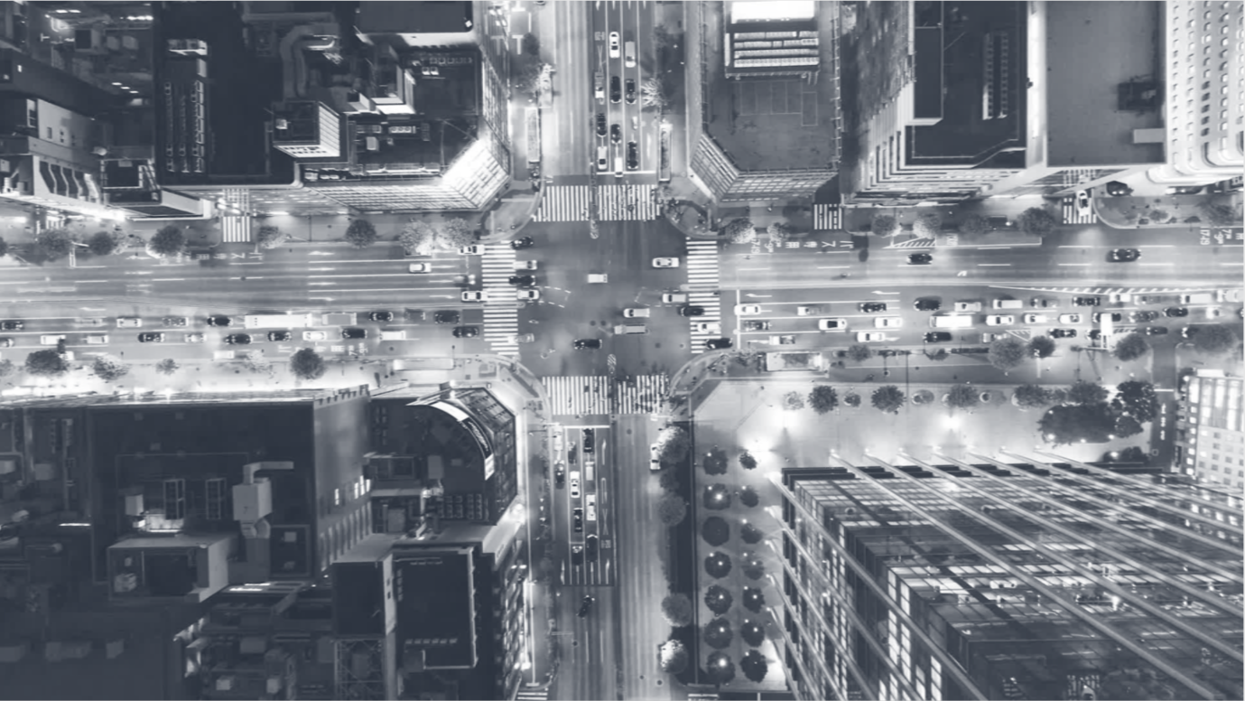




Speed to Market
Assembled rapidly
Multidisciplinary team
Quickly established priorities and assignments
Identified resources​ and on boarded key players ​ ​

Slide 8




Adaptations
Client centric
Modernized business process
Transformed governance

Slide 9




Methods
Agile and Sprint Methodology
Leveraging internal resources

Slide 10




Service
Unparalleled Level
Flexible
Long-term

Slide 11




Success Story
67M+ doses of vaccines delivered
9.8M+ vaccine administered
Countless amounts of data analysed

Slide 12




Critical
Future
Permanent

Slide 13

“Being a Project Product Manager is like being an artist, you have the different colored process streams combining into a work of art.”
Greg Cimmarrusti

